Slide 1
[Customer Name] Code Innovate
[Location of event]| [Date]
Notes:
Necessary Print-offs left at each seat before day begins:
Circle Activity (enough for proctors and participants)
Agenda (for everyone)
Piece of blank paper for Ideation activity
Use Case (enough for everyone)

Slide 2
[Customer Name]
Break New Ground
[CPR/ECA/IA Name]
[Title]

Slide 3
[Customer Name]
Break New Ground
[Exec Lead Name]
[Exec Lead Title]

Slide 4
Learner introductions
Tell us your Name, Department, and Title
What is something you enjoy doing?
What is something you’ve recently developed?
30 seconds or less
Notes:
Tell us your Name, Department, and Title
Depending on the event and the Exec Lead, you could be doing one of the two different Ice Breakers:
What is something you enjoy doing OR What is something you’ve recently developed?
This is the default for all Code Innovates
2 Truths and a Lie (This is for groups who are a little more relaxed)
Come up with two truths and one lie about yourself. When it’s your turn, share all three and the room will try and guess what is the lie.

Slide 5
What you will learn
Code Innovate Objectives:
Develop Together, Collaborate
Share Ideas & Best Practices
Establish Developer to Developer Relationships
Be willing to ask questions…
Provide feedback
Have fun!

Slide 6



Agenda
IDEATION
9:00 AM– 5:00 PM
ITERATION
9:00 AM – 5:00 PM
INNOVATION
9:00 AM – 5:00 PM
9:00 – 9:30 Welcome/Introductions
9:30 – 11:00 Structured Learning
9:00 – 9:15 Opening/Group Check-in
9:00 – 9:15 Opening/Group Check-in
11:00 – 12:00 Brainstorming/Ideation
9:15 - 12:00 Coding
9:15 – 12:00 Coding
12:00 – 1:00 Lunch
12:00 – 1:00 Lunch
1:00 – 1:30 Team Goal & Task Formation
12:00 - 1:00 Lunch & Group Photo
1:00 – 2:00 Coding and Integration
1:30 - 4:50 Coding
4:50 - 5:00 Group Check-in
1:00 – 4:50 Coding
4:50 – 5:00 Group Check-in
2:00 – 3:00 Lightning Talk Prep
3:00 – 5:00 Presentation & Awards
Notes:
Here is the general Agenda, now each Code Innovate is different. Some have Structured Learning and some do not. Some only have 2 days instead of 3. Use this as a template/guide when building out your agenda.

Slide 7
Structured Learning

Slide 8
Brainstorming & Ideation
Make, break, build.

Slide 9
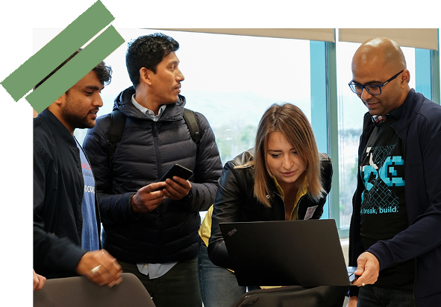
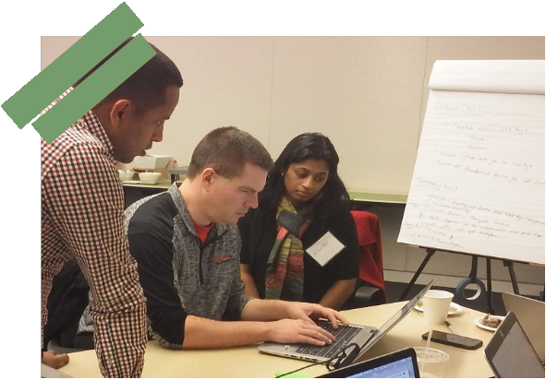
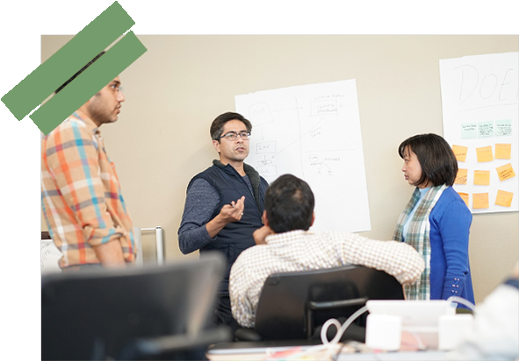
Ideation – Small Group Formation
Organize into groups of 3-5.
Engineer from Oracle will join group.
Team Building Exercise

Slide 10
Ideation – Part 1 – Face Activity
Use a fresh new sheet or back of circle activity
You will be partnered up with someone around you
When we start the timer, you will close your eyes and draw your neighbor’s face from memory
When we say GO you have - 1 minute

Slide 11
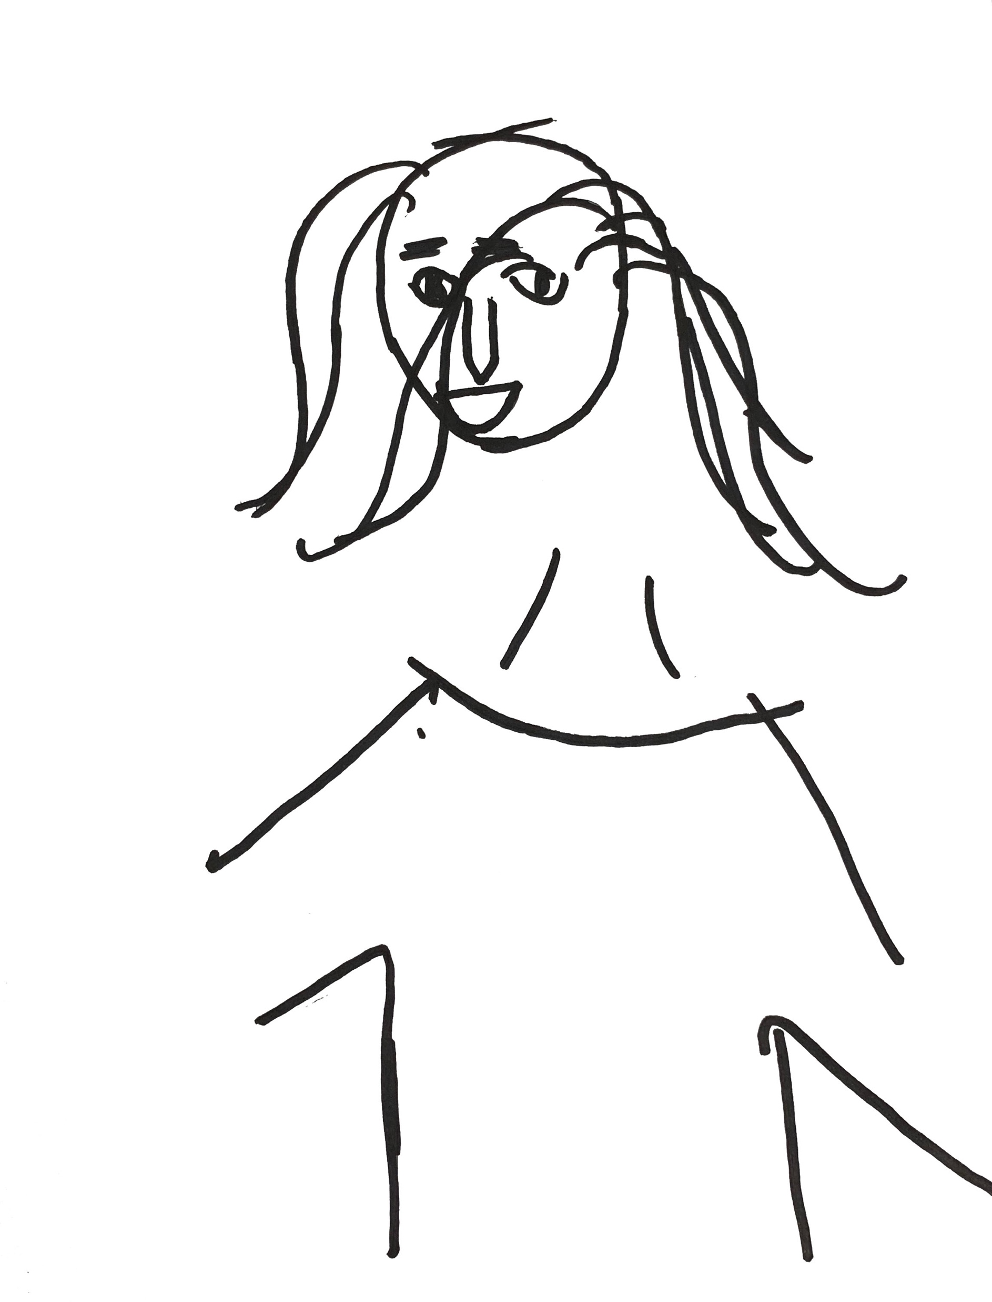

Face Activity
Notes:
Well many of you may be wondering why we had you close your eyes, draw someone’s face. Wouldn’t that be difficult, wouldn’t that be messy. That is what it is, that is by design. Often times, when you pick up a new technology, you pick up a new coding framework or a new product and you start to learn, we, as engineers, think that we should know it all and be able to plan it out. But the first time that we use the tools, use the technology, the first time that we touch the cloud, it can be messy. Just like drawing your friend’s face next to you, with your eyes closed. Think about this, what if you now opened your eyes and drew the individual next to you, would the picture be clearer? Would it be cleaner? It’d probably be a lot better for almost everyone in this room. Well, what we are going to do over the next three days is just that. We’re going to help open your eyes a little bit to what can be done within the cloud, so it may feel a little messy on Day 1 or Day 2, but by the end of Day 3 our hope for you is that your eyes have opened a little bit and you can see our Cloud a little cleaner, a little crisper and make some great progress.

Slide 12
Ideation – Part 2 - 30 Circles Exercise
You get a sheet with 30 circles
Transform each into something recognizable
Bike Wheel
Planet
Clown’s Nose
Etc.
It is OK to draw outside the lines
When we say GO you have 3 minutes

Slide 13

Goal: 30 circles - 3 minutes

Slide 14
30 Circles
Fluency
Flexibility
+
Notes:
So as we did this last exercise, I saw a lot of concern on faces as we got started. Concern because we gave you very obtuse, quick instruction. We didn’t tell you exactly what we wanted you to do and we clearly didn’t give you enough time to do it. And for many of you, that probably felt very uncomfortable. Well that was by design. You see, many times as engineers, we tend to be left brain and tend to love structure and plan everything out. We want to know exactly what to do and be successful with it by innovating along the way. Well, when you first start to use technology, that’s not always the case. And, this exercise, if you look across the room, what you’ll find is that everyone did things a little bit differently. Some of you took the minimalistic path to accomplishing 30 circles in 3 minutes by putting whatever popped in your mind into each circle. Where others of you, didn’t worry about filling in all of the circles themselves but took time and did detail. Got make a few circles really creative. And you know what, both paths are correct. As we move to Ideation, in our next phase, I ask you to keep this exercise in mind because as we ask you to put ideas up on the board about things that you would like to develop, ways to solve your business problems that your leaders have identified, or things you want to experiment with or try. There are no wrong answers. In this exercise, some of you may put up 20 ideas in 10 minutes, some of you may put up 5 and that’s ok. The key to success in Code Innovate is Diversity of Thought, making sure that we look at the same thing form different perspectives, different ways, and understand that we can’t always plan everything out. But with the ideas that we have, with the diversity of thought, we’re going to do the best that we can over the next 3 days to solve your problem.

Slide 15
Ideation: 5 mins.
Select a Team Name.
Write down the names of the members of your team.

Slide 16
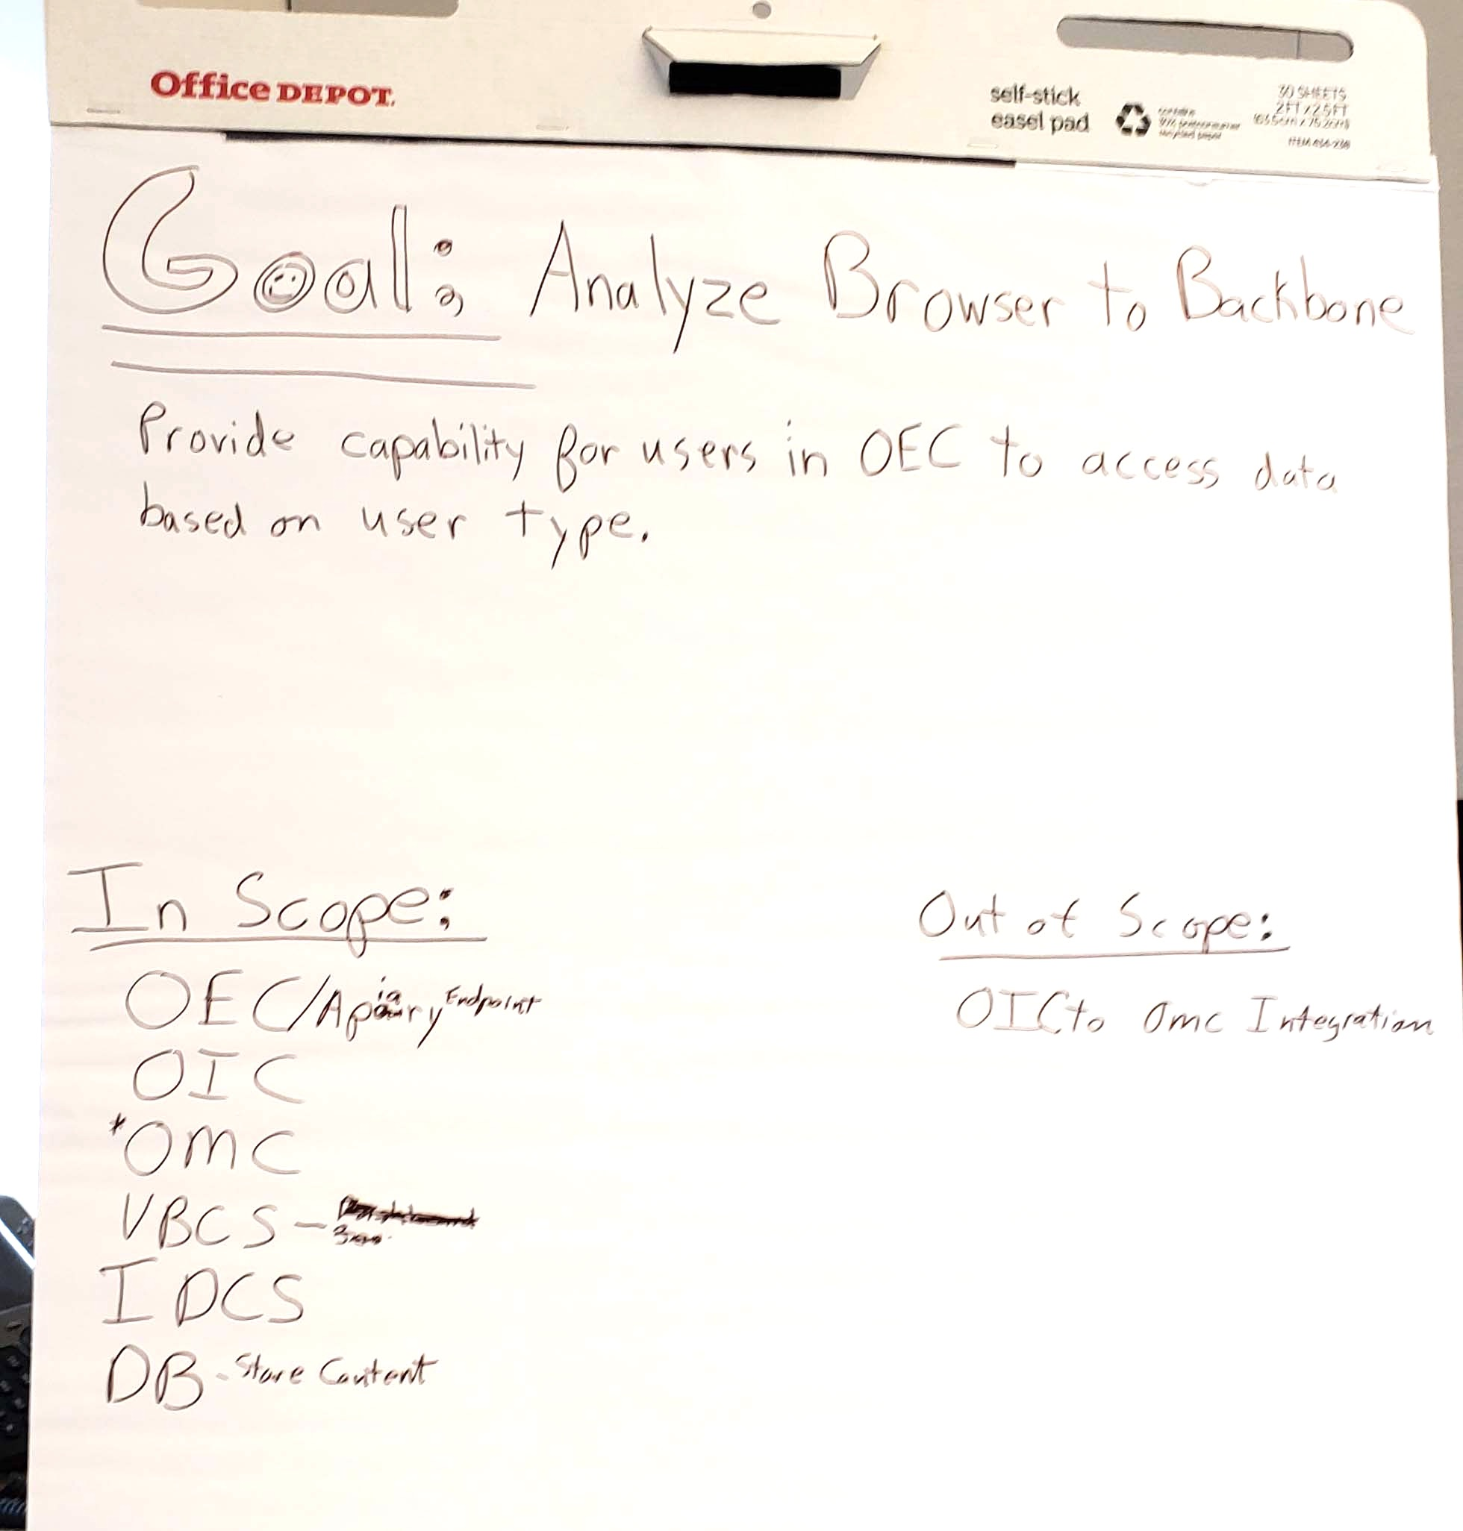
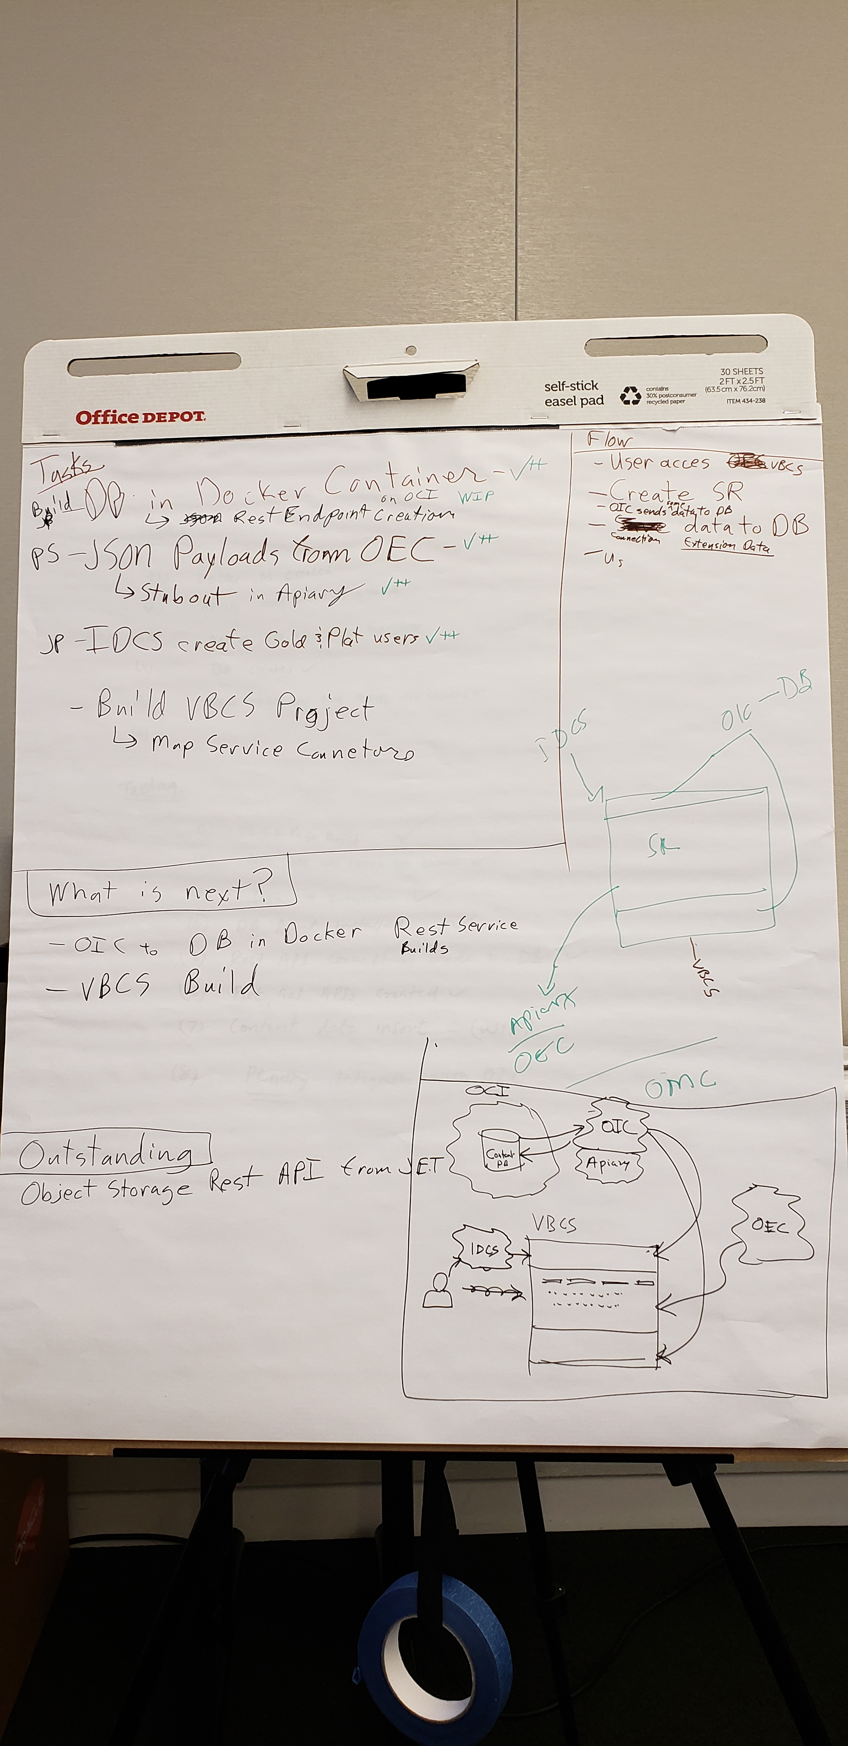
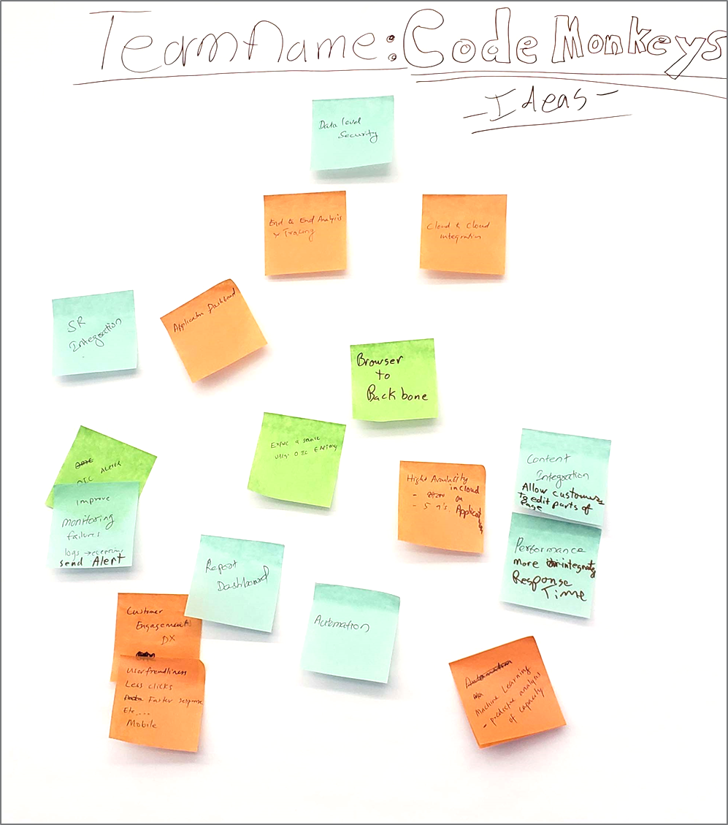
Ideation
Goal
Tasks
20 Minutes
Put ideas on sticky notes.
15 Minutes
Organize ideas into goal for group to accomplish in 3 days.
10 Minutes
Outline primary tasks, distribute tasks amongst group

Slide 17
Ideation: 20 mins.
Select different color sticky notes.
Gather with group in either room around poster board.
Put as many ideas as possible on the board.
What is it you would like to learn or try technically to solve the problem?
What do you think would help the business?
What other ideas do you have?

Slide 18
Ideation: Flip chart template
Team Name:
Ideas:

Slide 19
Goal: 15 mins.
Create a goal statement
Determine what is in scope or out of scope for a 3 day engagement.

Slide 20
Goal: Flip chart template
Goal:
In Scope:
Out of Scope:

Slide 21
Tasks: 10 mins.
List first 5-10 tasks for team.
Assign names to tasks.

Slide 22
Design & Develop
Let’s get started!

Slide 23
Check In: 4:50 PM
What were you able to accomplish?
What are you going to work on next?
Did you have any challenges or issues?

Slide 24
[Customer Name] Innovate Day 2 Design & Develop

Slide 25
Agenda
IDEATION
9:00 AM– 5:00 PM
ITERATION
9:00 AM – 5:00 PM
INNOVATION
9:00 AM – 5:00 PM
9:00 – 9:30 Welcome/Introductions
9:30 – 11:00 Structured Learning
9:00 – 9:15 Opening/Group Check-in
9:00 – 9:15 Opening/Group Check-in
11:00 – 12:00 Brainstorming/Ideation
9:15 - 12:00 Coding
9:15 – 12:00 Coding
12:00 – 1:00 Lunch
12:00 – 1:00 Lunch
1:00 – 1:30 Team Goal & Task Formation
12:00 - 1:00 Lunch & Group Photo
1:00 – 2:00 Coding and Integration
1:30 - 4:50 Coding
4:50 - 5:00 Group Check-in
1:00 – 4:50 Coding
4:50 – 5:00 Group Check-in
2:00 – 3:00 Lightning Talk Prep
3:00 – 5:00 Presentation & Awards

Slide 26
Check In: 10 mins.
What are you going to work on next?
Ideas: For Development
If your SME has to leave early, interview them first thing in the AM.
Divide and conquer development. Assign your engineer tasks.
Expand Scope or Polish, if you complete original scope.

Slide 27
[Customer Name] Code Innovate Day 3 Development Wrap-up, Lightning Talks

Slide 28
Agenda
IDEATION
9:00 AM– 5:00 PM
ITERATION
9:00 AM – 5:00 PM
INNOVATION
9:00 AM – 5:00 PM
9:00 – 9:30 Welcome/Introductions
9:30 – 11:00 Structured Learning
9:00 – 9:15 Opening/Group Check-in
9:00 – 9:15 Opening/Group Check-in
11:00 – 12:00 Brainstorming/Ideation
9:15 - 12:00 Coding
9:15 – 12:00 Coding
12:00 – 1:00 Lunch
12:00 – 1:00 Lunch
1:00 – 1:30 Team Goal & Task Formation
12:00 - 1:00 Lunch & Group Photo
1:00 – 2:00 Coding and Integration
1:30 - 4:50 Coding
4:50 - 5:00 Group Check-in
1:00 – 4:50 Coding
4:50 – 5:00 Group Check-in
2:00 – 3:00 Lightning Talk Prep
3:00 – 5:00 Presentation & Awards
Notes:
Here is the general Agenda, now each Code Innovate is different. Some have Structured Learning and some do not. Some only have 2 days instead of 3. Use this as a template/guide when building out your agenda.

Slide 29
Check In: 10 mins.
What are you going to work on next?
Ideas: For Development
Plan tasks to completion before Lightening Talk Build.
Work with engineers on notional architecture.
Practice presentation &demo.

